Slide 1

Fundamentals of Cloud Computing
Aaron Wells – Indiana University
Presented by Rob Quick
STEP1 Program – Miami, FL – 19 May 2025

Slide 2
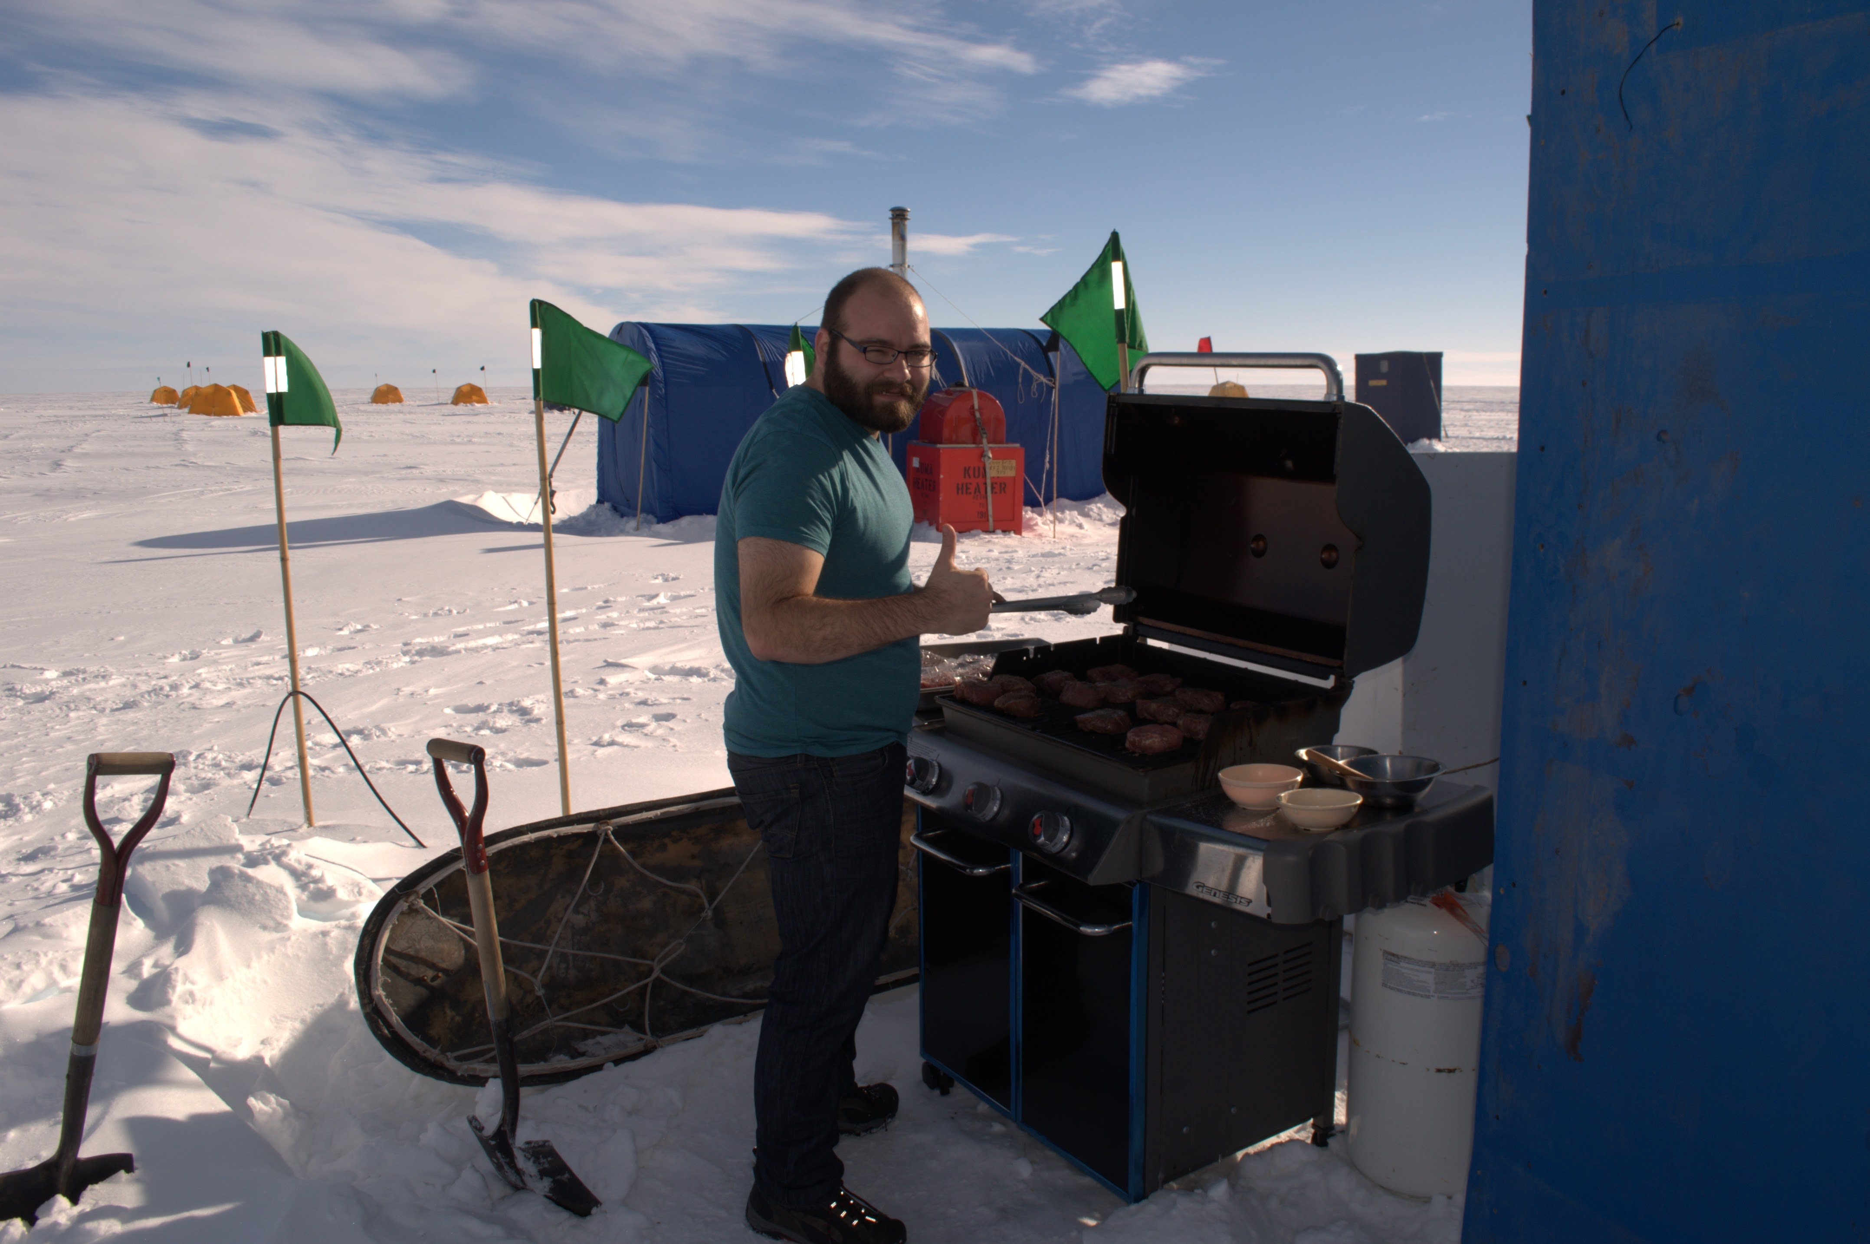
Background
Worked in IT since 2008
Most of my time at IU worked on a project called “Operation Ice Bridge” with helped map land and sea ice in Greenland and Antarctica
Running a datacenter in an airplane
Typical Data collection ran about 5-6 TB a day and around ½ PB a season.
Grilling in a field camp in Antarctica (2016)

Slide 3
There is no shame in looking stuff up
There is no shame in looking stuff up or ($searchengine)’ing for answers.
There are so many commands for software that it’s hard to keep track of what does what and how possible in minor version releases flags change.
The most important thing I’ve found in my career is learning how to find new information and not memorizing old information.

Slide 4
Vocab and Key Concepts
Virtualization
Scalability
High Availability
Cloud Security
Virtualization
Process of creating virtual (software defined) resources.
Computers
Networks
Hard drives
Enables efficient resource utilization
No longer need a 1 to 1 server to application
Notes:
Virtualization is the process of creating virtual instances of physical resources, such as servers, storage, and networks. Virtualization enables efficient resource utilization, allowing multiple virtual machines to run on a single physical server. This technology is crucial to cloud computing, as it provides the foundation for offering scalable and flexible computing resources.
Efficient Resource Utilization - Allows multiple Virtual! Servers to live on the same hardware as a single physical server. Not limited to being the same OS as the host server. i.e. can have a windows mail server or .net server running on a linux host server.

Slide 5
Vocab and Key Concepts cont.
Virtualization
Scalability
High Availability
Cloud Security
Scalability
Horizontal
Adding more servers to fit the need
Vertical
Increasing the resources per server to fit the need.

Slide 6
Vocab and Key Concepts cont.
Virtualization
Scalability
High Availability
Cloud Security
High Availability
Before cloud computing when a server or network failed due to hardware, it was troublesome to migrate or restore data
Now with cloud computing, you can just migrate the VM to new hardware.
Computing resources in multiple regions reduces risk due to natural disaster
Notes:
The ATT Telephone network (wired) bragged about 99.9999% reliability. One of the greatest tricks of cell phone marketing was to get users to be ok with dropped calls.

Slide 7
Vocab and Key Concepts cont.
Virtualization
Scalability
High Availability
Cloud Security
Security
Not just firewalls
Identity Management
Regular Security Audits
Strong encryption (if needed)
Also, firewalls.
Security groups
Notes:
Identity Management: Logging who has access and when they accessed a resource. Two factor, limited accounts.
Regular Security Audits
More about this on Wednesday.

Slide 8
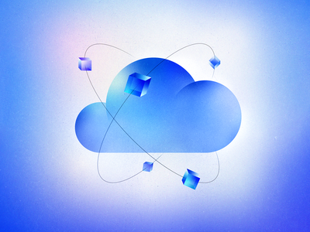
Defining what cloud is…
On-demand computing resources
Common examples are:
Storage
Compute
Software
Often called XaaS (Something as a Service)
At the simplest level, you’re renting resources when you use most cloud resources
Anatolii Babii - https://www.behance.net/gallery/117344467/Cloud-Services-Illustrations
Notes:
Infrastructure as a service (IaaS) offers on-demand access to IT infrastructure services, including compute, storage, networking, and virtualization. It provides the highest level of control over your IT resources and most closely resembles traditional on-premises IT resources.
Platform as a service (PaaS) offers all the hardware and software resources needed for cloud application development. With PaaS, companies can focus fully on application development without the burden of managing and maintaining the underlying infrastructure.
Software as a service (SaaS) delivers a full application stack as a service, from underlying infrastructure to maintenance and updates to the app software itself. A SaaS solution is often an end-user application, where both the service and the infrastructure is managed and maintained by the cloud service provider.

Slide 9
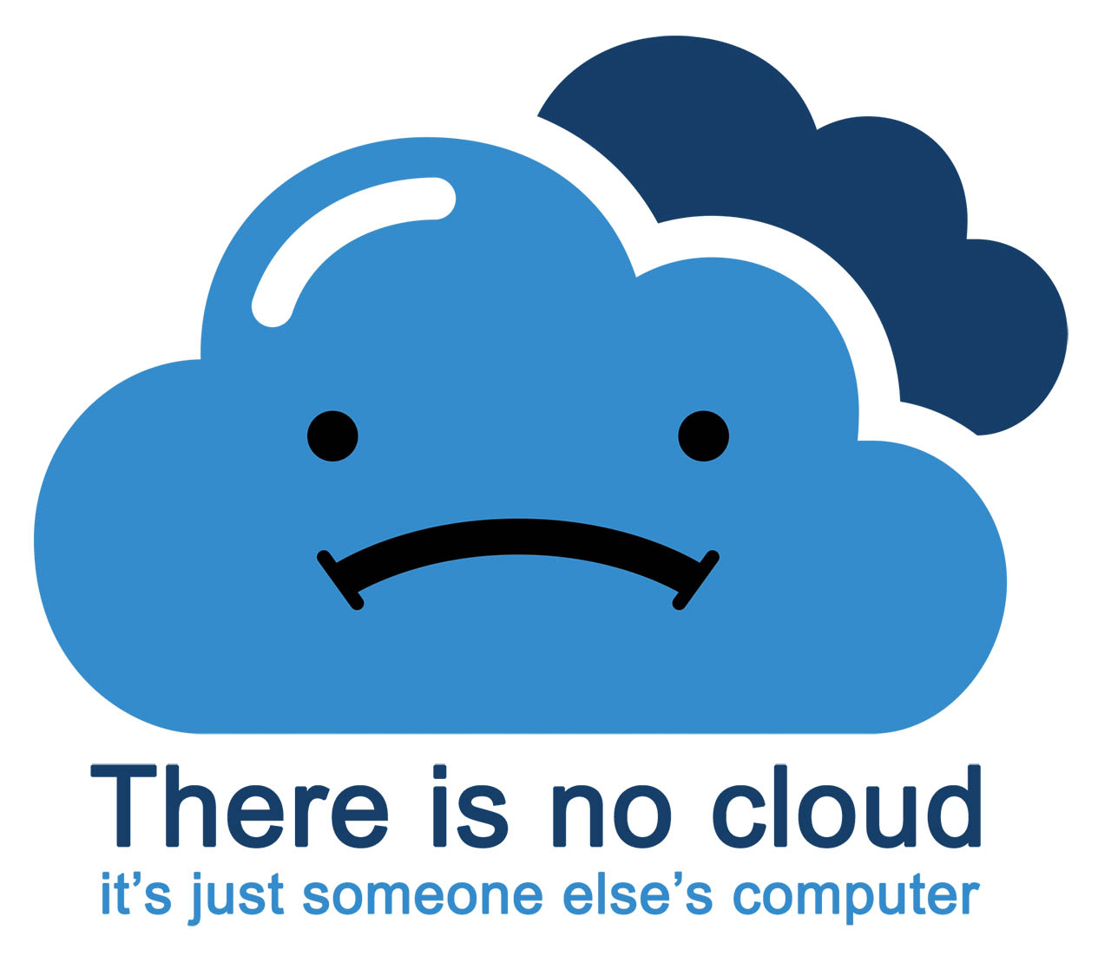
The cloud reality…
Notes:
There’s no magic in “the cloud” – it really is just someone else’s computer that you’re paying to use. It’s a convenience factor or cost factors of hosting your own hardware.
It’s just important to keep perspective that every service is backed by something and someone.
And the pic is just funny. ☺

Slide 10
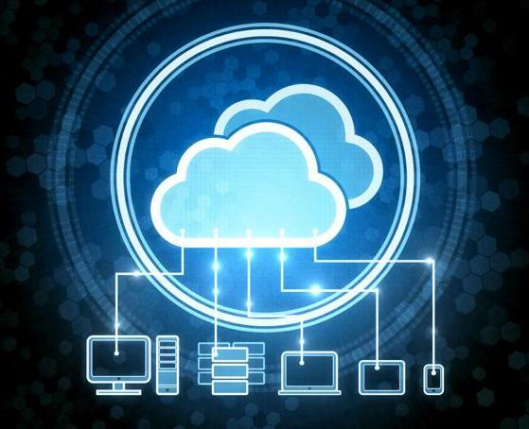
Why use the cloud?
Convenience
Security*
Access to unique or scarce resources
Access to more resources than you could otherwise have available
Short-term need**
Low-cost***
Mix and match services fairly easily
* Security is a slippery topic here
** More for compute than storage *** Here there be dragons
Notes:
The convenience factor is a key for things like storage where you want to be able to access the same files from many locations relatively seamlessly. Or run software from multiple devices where you can use per-seat licensing from cloud services (like Adobe Photoshop cloud edition as an example) without having to buy multiple licenses – also saving money.
Security – well, that’s a fallacy a lot of corner office types buy into – if it’s compute, it’s only as secure as the people managing it. At any rate, security refers to the infrastructure. Presumably the resource providers (e.g. Google) are trying to keep these services secure. Just keep in mind that it’s no substitute for good security practices all around
Scarce or rare resources – perhaps your institution or company doesn’t have access to high end GPUs or particular FPGAs – there’s almost certainly a cloud environment out there where you can rent access to it to try your code or experiment with without having to invest in the hardware yourself. Perhaps it ultimately leads to you buying it, but it gives you a way to try before you buy. Or to just use someone else’s resource as you need it.
More resources – many small companies don’t have their own data centers and it’s just not economically feasible to have one with adequate cooling, power, and staffing. Cloud resources might let you have more resources than you could easily have otherwise – or if you have a problem you just need more processing power to solve, cloud compute resources might let you do that sooner rather than later.
If you need something for a short time, it may be cheaper to rent it via cloud rather than invest permanently in a resource on premises. Most people tend to look at storage as a parking lot. Compute tends to be more of an on demand thing in research – though for companies providing services, “always on” technologies for running web or db services are common.
Low cost – many people are dazzled by what appears to be really low costs. And sometimes the services are VERY affordable. There are just lots of ways you can accidentally run up a big bill. Pay attention to the fine print – watch for ingress/egress fees and any other costs that may be masked or hidden. Pretty much everyone in academia has or knows someone with an AWS “dear god look at this bill” story. ☺
Mix and match services – what it sounds like. Sometimes you need a variety of things and cloud services from one or more vendors may let you do that easily.

Slide 11

Why not use the cloud for everything?
Usually cost
Rates today do not equal rates tomorrow
Dedicated access to resources
Keeping proprietary information on premises
Rrraum/Shutterstock
Notes:
A common fallacy that we’ve covered is that cloud resources are always cheap – they might be (and often are) cheap for particular use cases, but it merits analysis on whether it might be more economical in the long term to have your own on premises resources. Most institutions, private and public, often find that a mixed portfolio of cloud and on-premises services make the most sense. It’s not simple but always worth making careful analysis on services that you intend to run/have/need for the long term before just blindly writing a check to your cloud provider of choice.
Sometimes, especially for things like HPC, where an academic or research institution might have large needs, you may want dedicated access – not having to share or wait for resources in the cloud if you’re accessing them on demand. (And not pay a high cost for lots of dedicated cloud resources if you need them constantly)
Proprietary information – while security is still a slippery slope, often keeping things on premises means you can better limit outside access. It still requires having qualified security staffing whether you opt to stay on site or in the cloud.

Slide 12
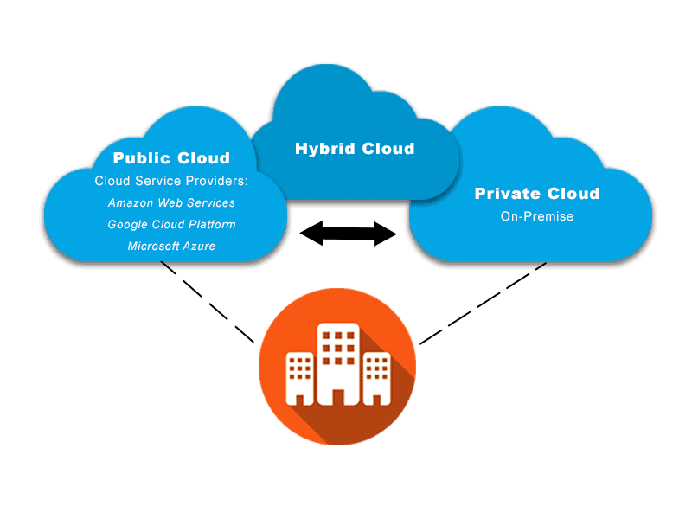
Types of clouds
Public Clouds
Private Clouds
Hybrid Clouds
Notes:
Hybrid clouds are rarely discussed – basically have an on-prem component but have some services in commercial cloud or may burst to public cloud on demand (in the case of compute resources)
Hybrid clouds often make sense when you may have public facing data and private data. You keep the private data on premises, hopefully behind a defense-in-depth approach to keep it secure while public facing services (a la public web sites and public data) may live in the commercial cloud.

Slide 13
HPC vs Cloud
Adapting to a different environment:
No reservations, no queueing – more interactive usage
Being your own admin – hey, we have root!**
You really can have almost any (linux) software you want**
** Here there be dragons…
Notes:
Skip over if nobody has HPC experience

Slide 14


Jetstream and way of the cloud…
Cloudy Technologies: clouds are more than just virtual machines (VM)
Old way: robust (expensive) infrastructure, weak (cheap) software
You expect the hardware to not fail
State is maintained in volatile data structures
Cloudy way: commodity infrastructure, robust software
Expect & plan for infrastructure to fail
Put intelligence into the software to handle infrastructure failure
And my favorite…

Slide 15
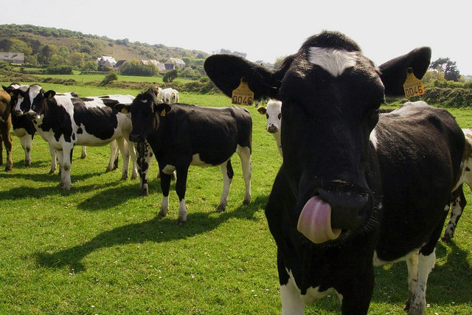
Thinking about VMs…
Cows, not pets: pets take great amount of care, feeding, and you name them; cows you intend to have high turnover and you give them numbers.
-- Mike Lowe (Jetstream2 architect)
**some caveats for gateways…

Slide 16
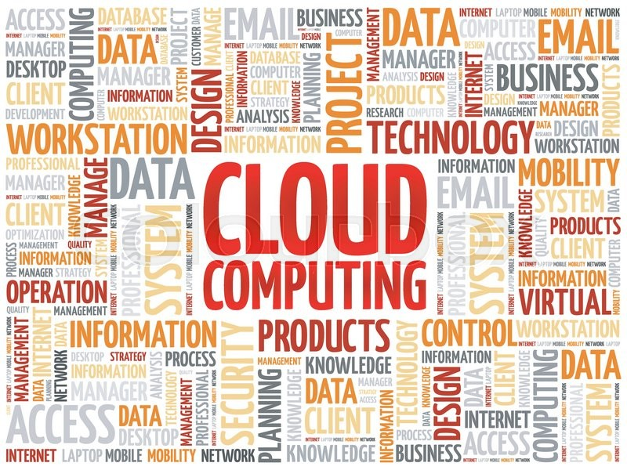
The Vocabulary of the Cloud

Slide 17
Cloud computing terms…simplified
Image: a file on a disk. It will be booted to create an…
Instance: a running virtual server; i.e. something you can log into.
State: something worth remembering; i.e. the state of the system

Slide 18
Cloud Computing Terms…simplified
Flavor: the size of a running instance; i.e. #core, RAM, disk
Hypervisor: the thing the instance runs on; something akin to a software defined hardware compute server.
Snapshot: the process of taking an instance and turning it to an image.
Security groups: Access Control List (ACL) that dictate the flow of traffic in AND out of your Instance

Slide 19
Cloud Computing Terms…simplified
States:
Running: the instance is up & running
Suspended: the instance is memory resident on the hypervisor but not running
Stopped: the instance is shutdown akin to powering down
Shelved: the instance is shutdown, written to disk, and stored
ACCESS/Jetstream specific information:
https://docs.jetstream-cloud.org/general/access/

Slide 20
Cloud Computing Terms…simplified (Cont.)
Object store: a blob of bits; it has a starting address & a size. There may be metadata associated with the object. The data is consumed in a streaming manner.
Block store: a software defined entity akin to an unformatted hardware disk drive, data is stored in blocks and has no metadata associated at the lowest levels
Filesystem: hierarchical in nature, directories & files, ability to open, seek, read, write.
Persistent storage: If you pull the plug, it will still exist when power is restored. Safe to store data or state here.
Ephemeral storage: If you pull the plug, it no longer exists. (Don’t leave your data here!!!)

Slide 21
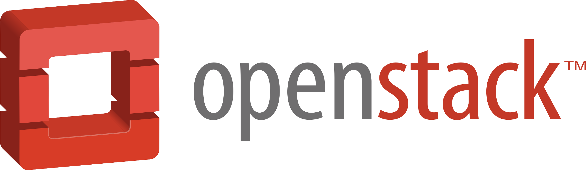

Jetstream: an NSF public science cloud
Jetstream2 is a research and education cloud funded by the National Science Foundation
It runs on OpenStack, an open source cloud platform
Jetstream2 will be covered in a session after lunch
It will be where we run the hands-on exercises

Slide 22
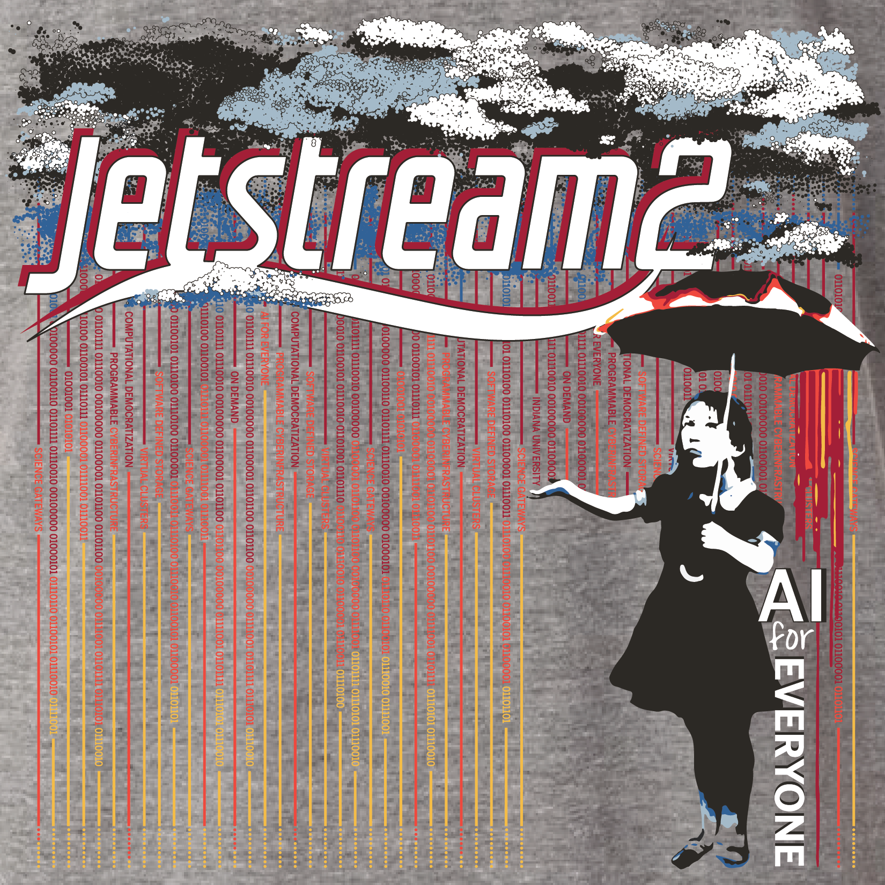
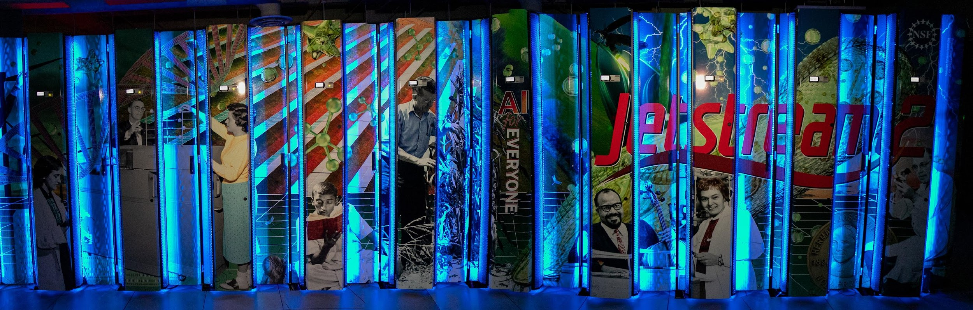
What is “the” Jetstream(2)?
NSF-funded production cloud environment
Ease-of-use focus, rapid on-ramp to XSEDE/ACCESS
On-demand interactive computing and persistent services for science gateways
Enables configurable environments; programmable cyberinfrastructure
State of the ART!
By Maria Morris: JS2 rear doors (lower) Banksy adaptation [non-commercial] (right)
Now with GPUs, large-memory, faster PB!

Slide 23


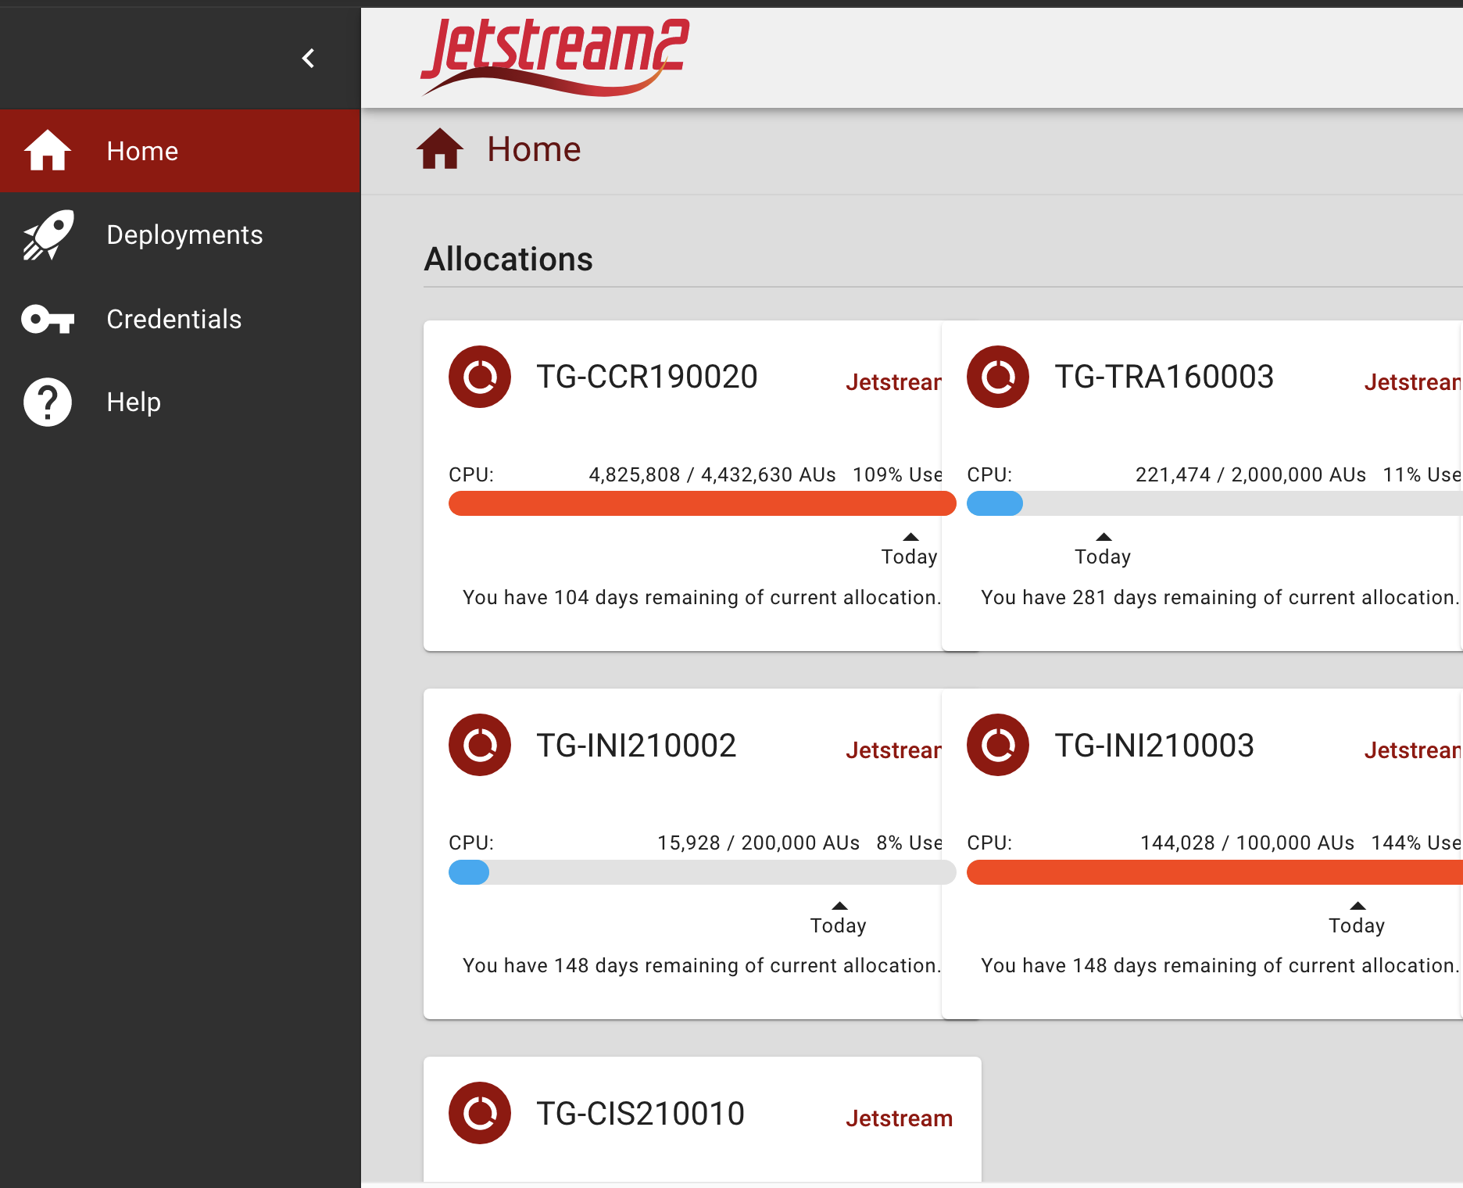
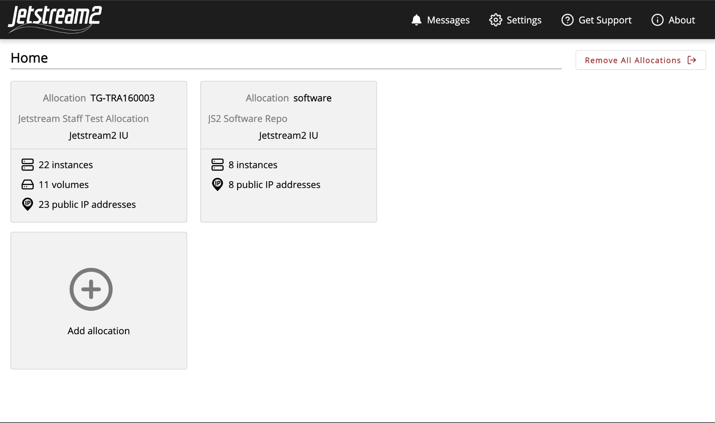
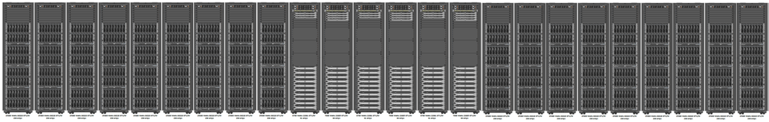
Platform Overview
Science Gateways
Horizon
OpenStack CLI
Cacao
Exosphere
Authentication Service
XSEDE Accounting
OpenStack
Ceph
OpenStack
Jetstream2 Core System
Notes:
Note the multiple touch points for users, won’t dive deep into the architecture
Speak to how these interfaces serve different communities/purposes

Slide 24
OpenStack Intro

Slide 25
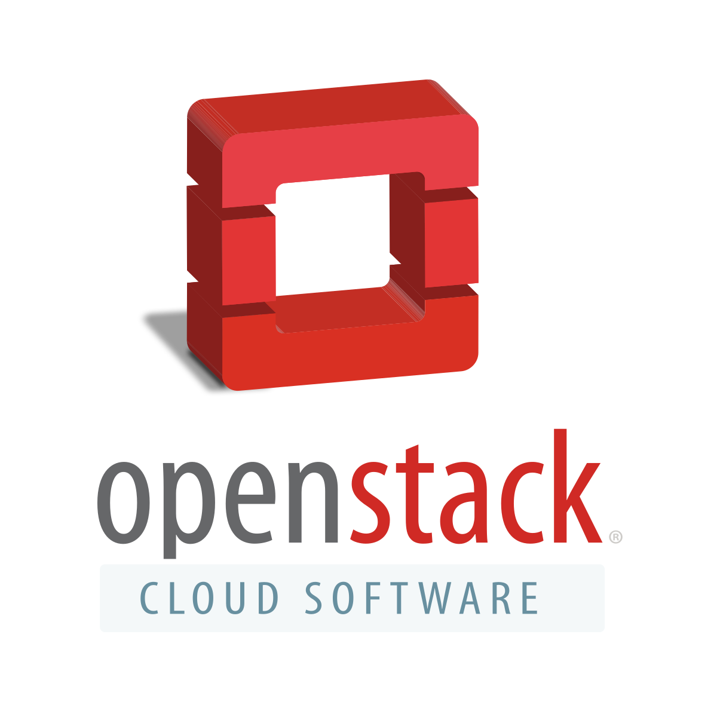
What is OpenStack?
OpenStack is an open source cloud platform
As of Feb 2022, one of the three most active open source projects, along with the Linux kernel and Chromium browser
Provides general purpose cloud services for public or private clouds
Lots of commercial use and development with OpenStack!
Has a set of standard core services (auth, images, networking, compute, etc) and many add-on services (container orchestration, filesystems as a service, object store services, etc)

Slide 26





OpenStack Overview
Glance
Keystone
Token
Client
Ceph
Compute
Nova
Cinder

Slide 27
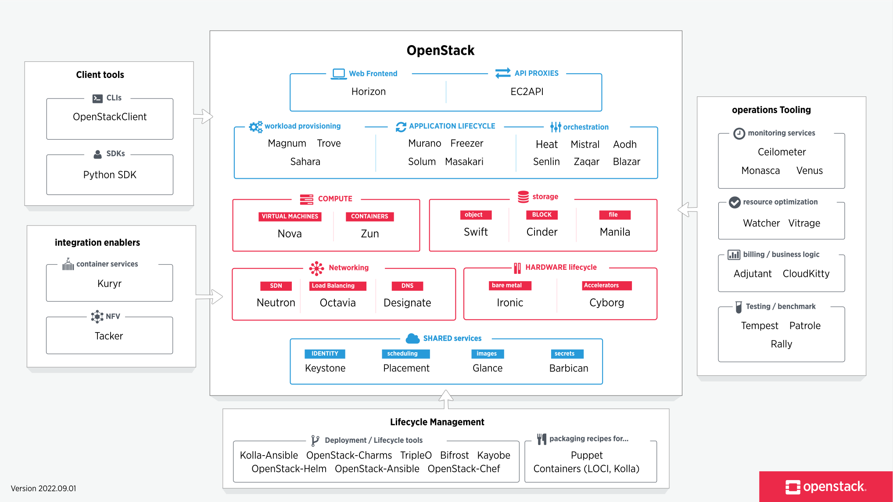
Notes:
!!! Quickly!!! Move past this slide to just show that the world of openstack is vast and full of dragons

Slide 28
OpenStack/Software Layers on Jetstream
Applications: custom software, standard software (Python, R, Matlab, etc)
VMs (running Ubuntu, Rocky, Alma, CentOS)
Software interfaces
Exosphere web interface
CACAO web interface
Horizon web interface
Command line interface
OpenStack: software tools for building and managing cloud computing platforms for public and private clouds.
KVM hypervisor: what the VMs run on
Ceph: storage platform that stores data on a single distributed computer cluster, and provides interfaces for object-, block- and file-level storage.

Slide 29
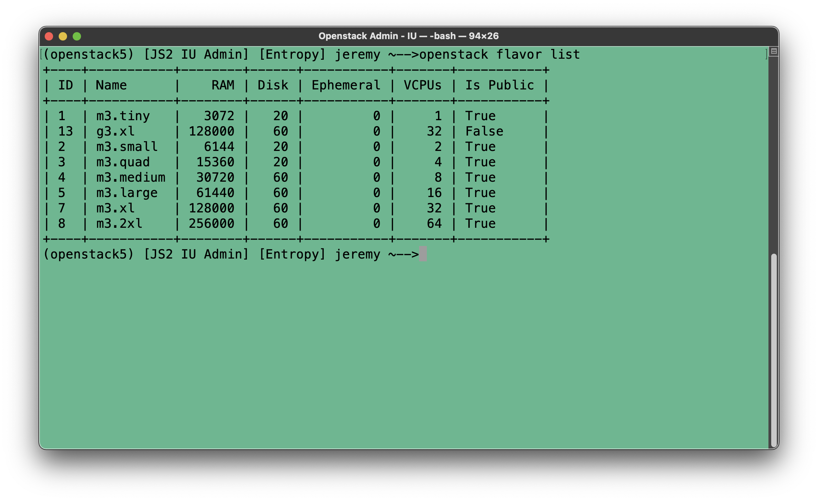
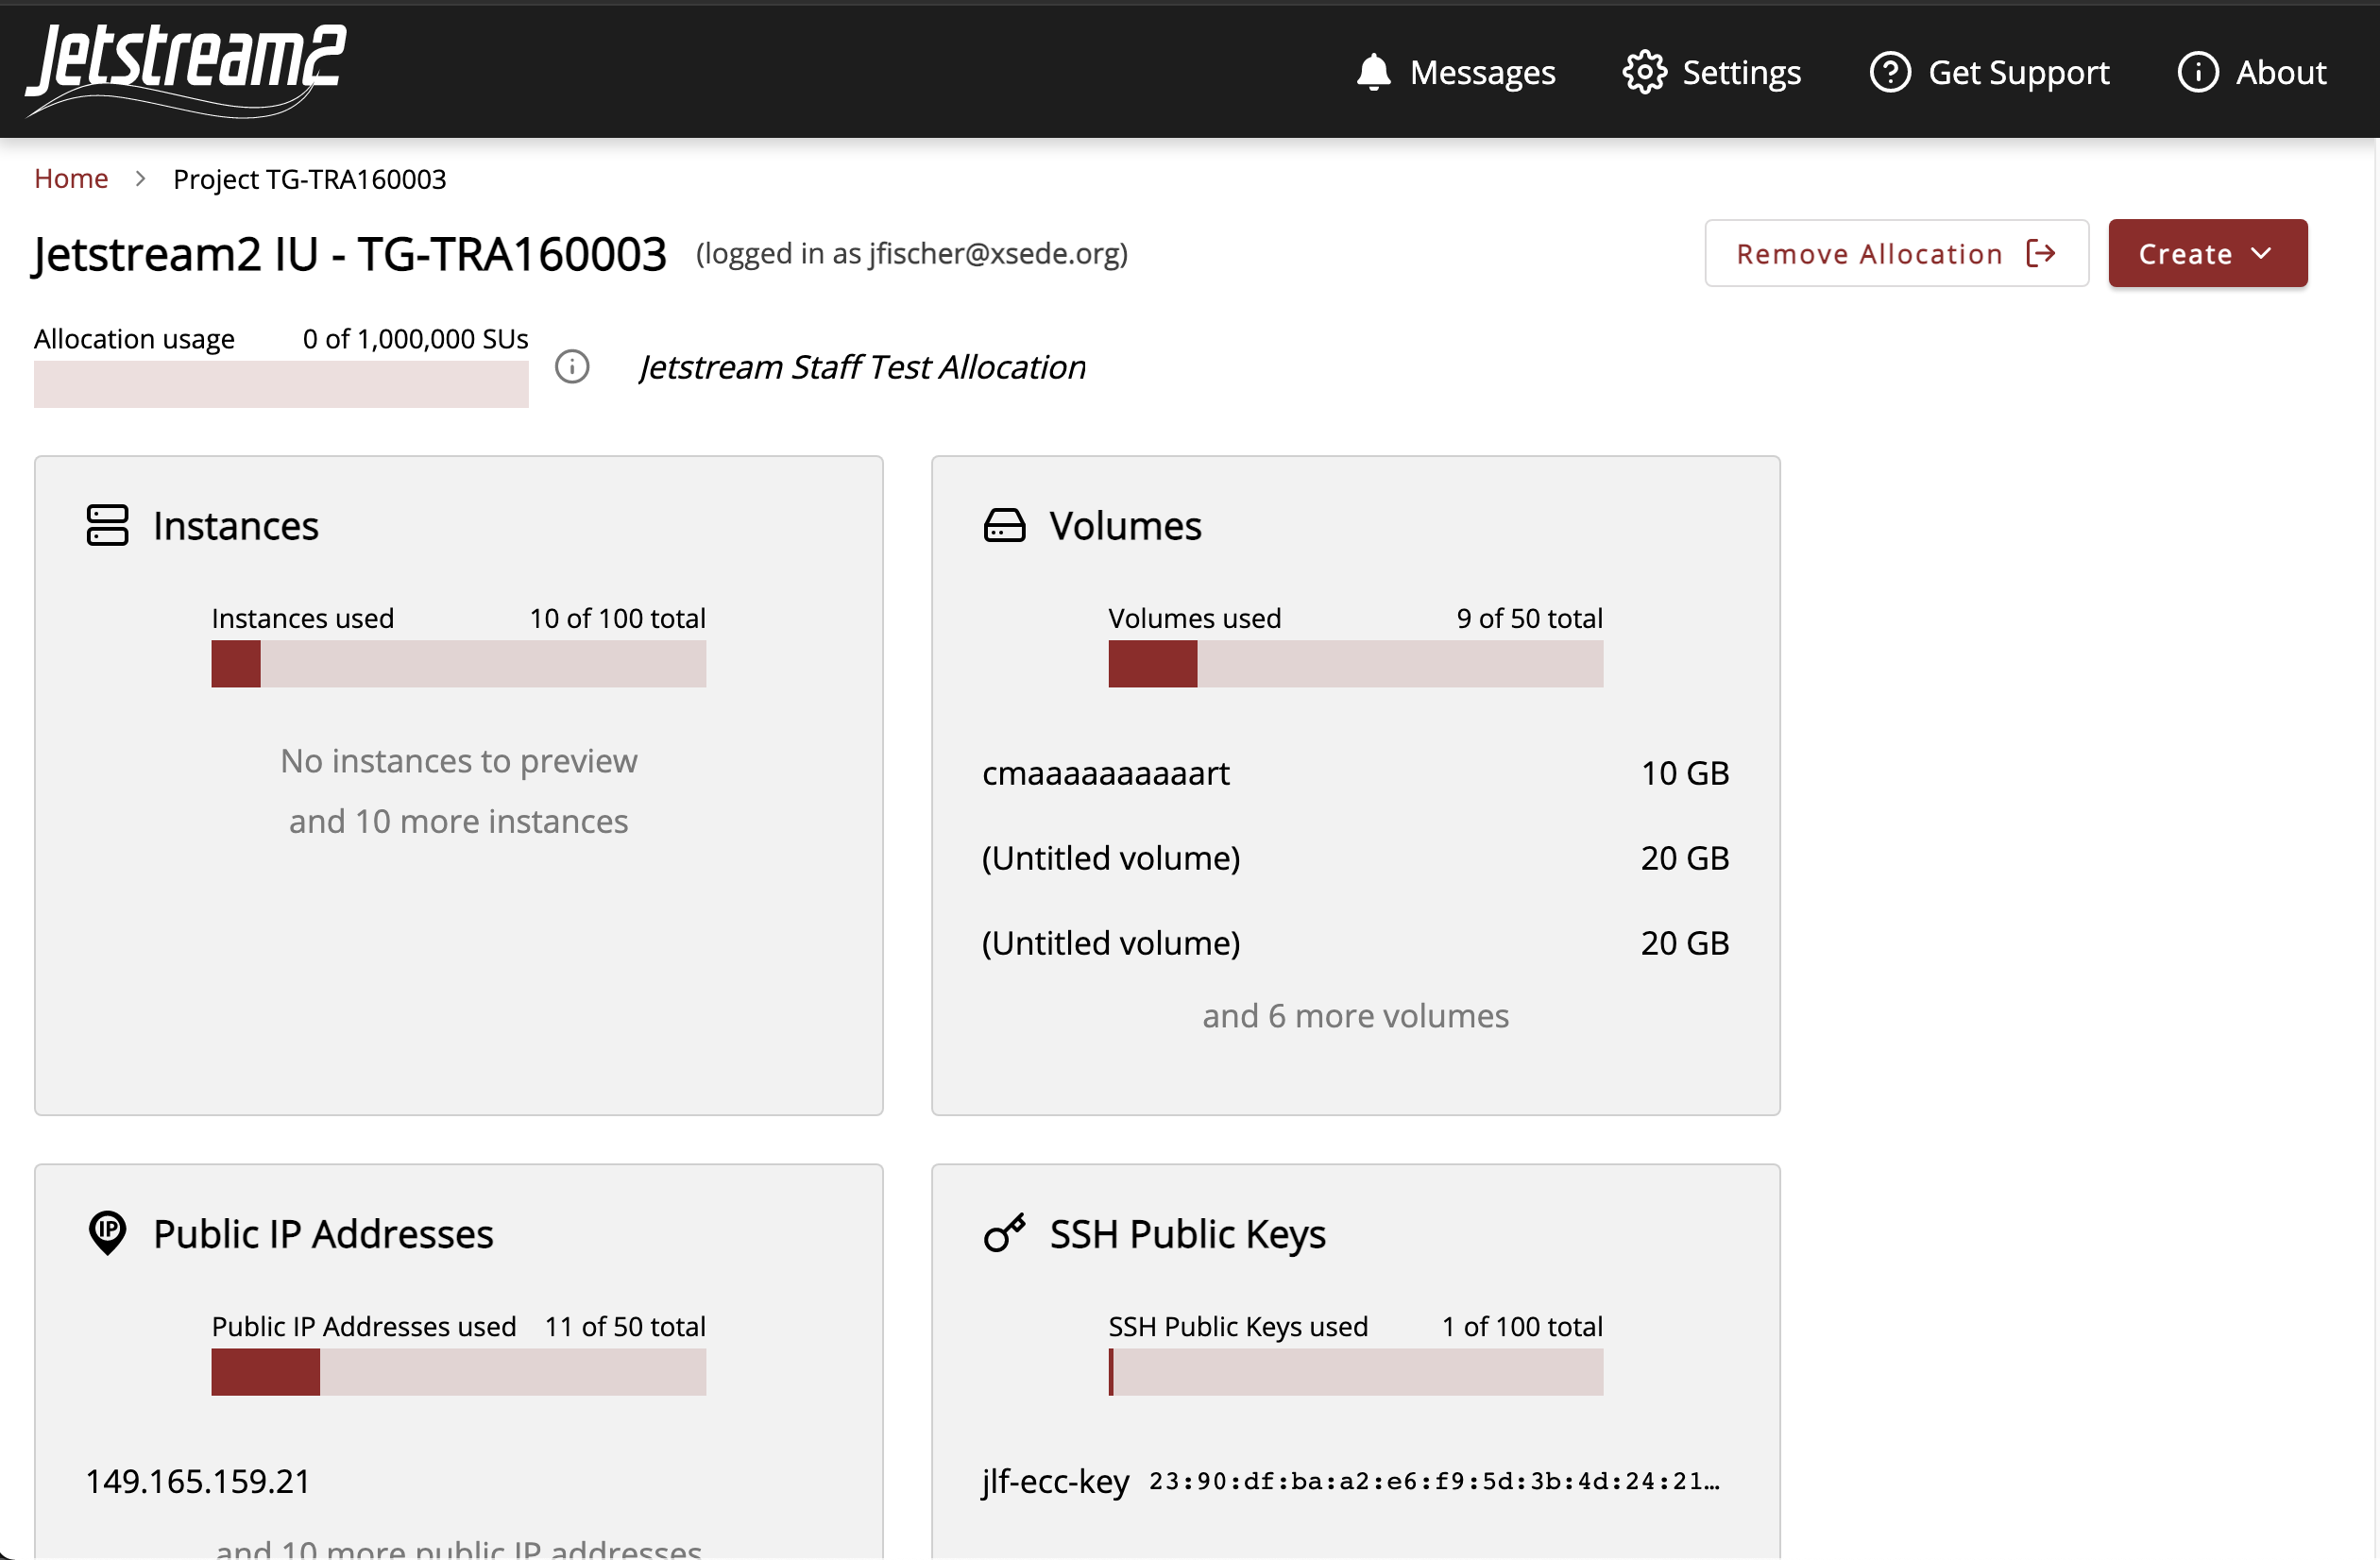
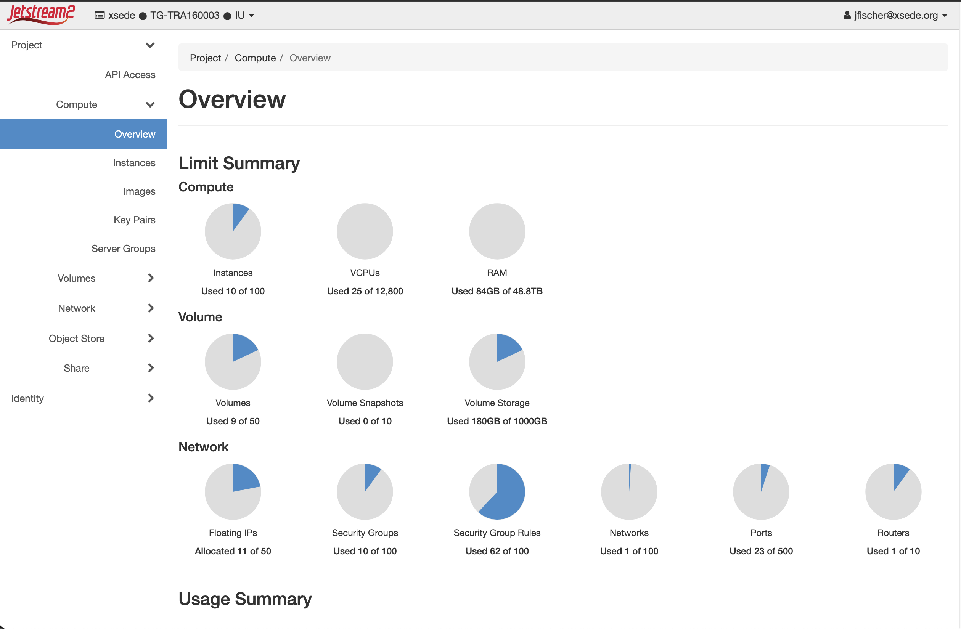
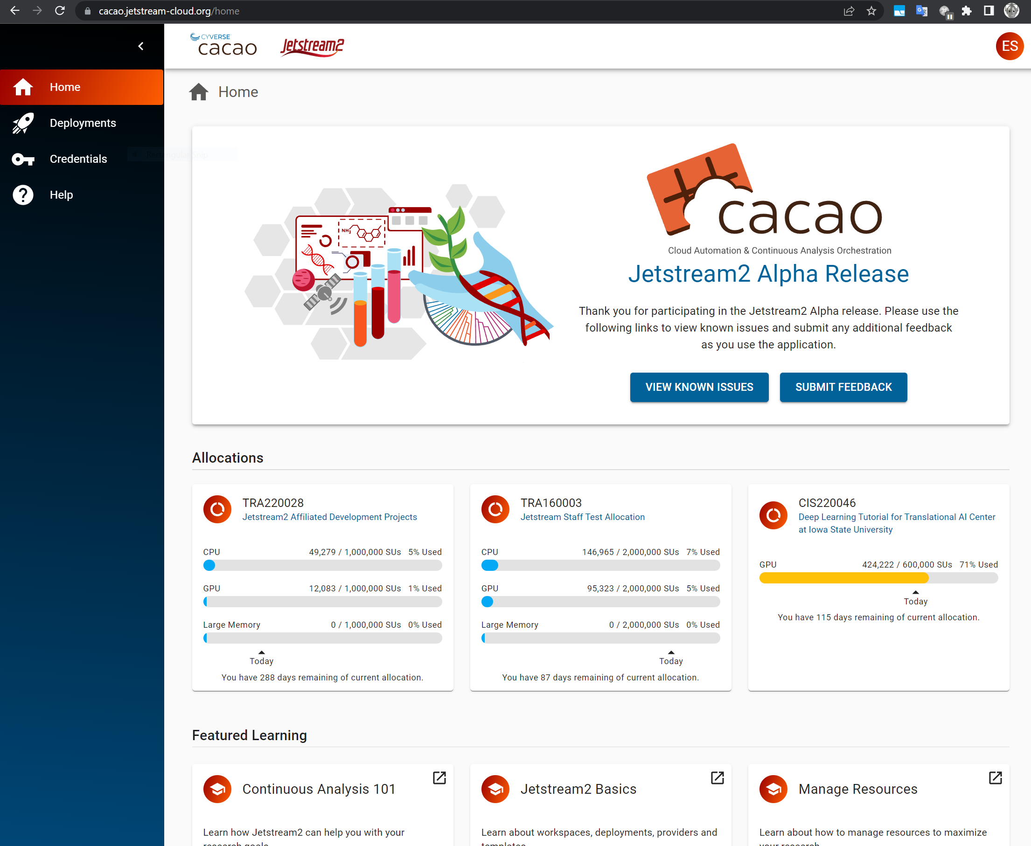
How do I access Jetstream2?
https://docs.jetstream-cloud.org/overview/overview-doc/

Slide 30
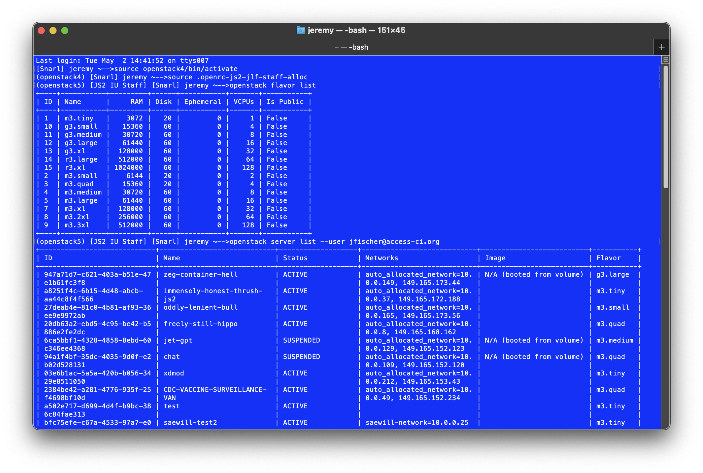
CLI / API Interface

Slide 31
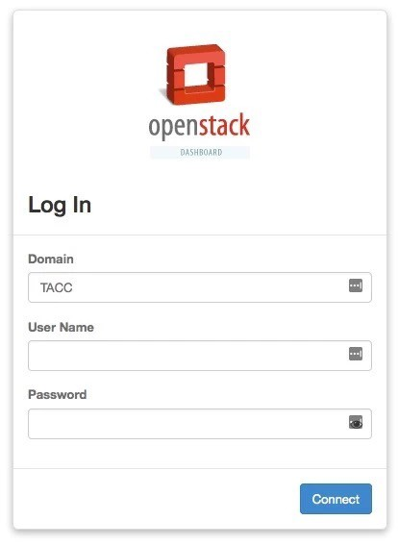
Horizon GUI interface
Allows most things you can do from the CLI
Nice for some tasks
Network visualizer is something we tend to use as a troubleshooting tool
Easier to look at security groups on Horizon (IMHO)
Downsides:
considerably slower than using CLI
not all features are present that are in CLI
can’t do things programmatically

Slide 32
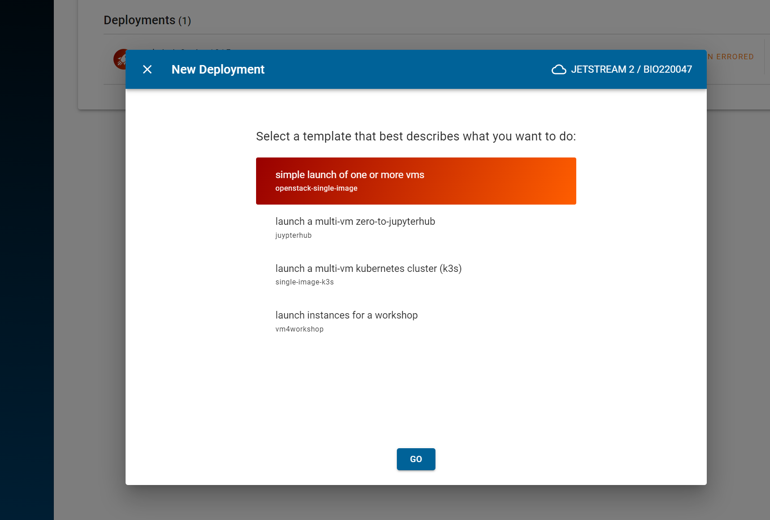
CACAO
https://cacao.jetstream-cloud.org
Notes:
Template driven for more complex workflows

Slide 33

Exosphere GUI interface
Primary Jetstream2 user interface
3rd party GUI interface for OpenStack clouds
Developers have a past connection to Jetstream but are working with multiple cloud providers
Attempting to fill the gap between interfaces built for system administrators like OpenStack Horizon, and intuitive-but-proprietary services like DigitalOcean
More about Exosphere:
https://gitlab.com/exosphere/exosphere

Slide 34
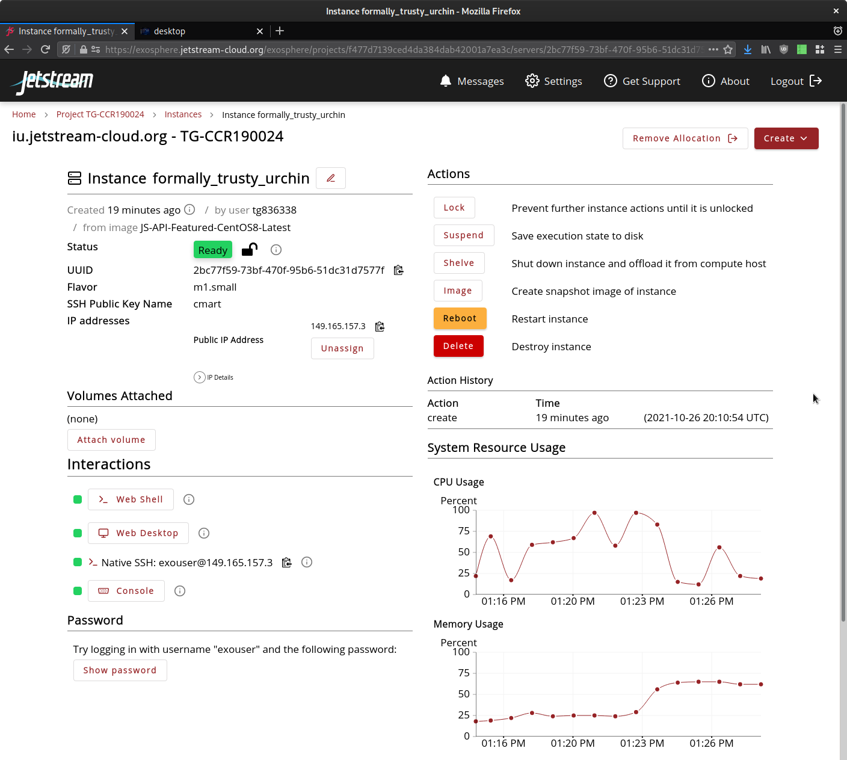
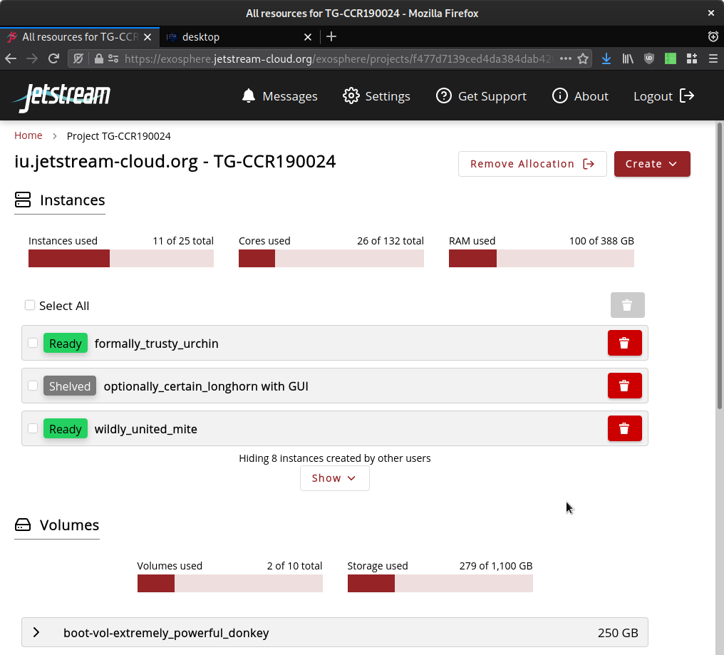
Exosphere
https://exosphere.Jetstream-cloud.org or try.exosphere.app
Notes:
Jetstream2.exosphere.app – Differences from JS1 GUI
Co-exists with other OpenStack interfaces, other research clouds
Much easier collaboration between users on same allocation
Choose an operating system instead of browsing a list of images
Multi-instance create and delete
Volume-backed instances ➡ large, persistent root disks
Live instance load graphs (CPU, GPU, RAM, storage)
Live instance resize
Push-button virtual clusters with elastic scaling
Reproducible workbenches with Binder-compatible repositories

Slide 35
Using and preserving VMs
You can install just about anything*
But generally limited to Linux**
Snapshots are fairly simple and easily shared with your allocation
One general practice is often to pull from Git(hub/lab) or pull a container
* Standard warnings about licensed software here.
** Here there be dragons.

Slide 36
Jetstream General Best Practices
Think about your security groups and only open what you REALLY need to open. (Horizon, CLI primarily)
Give objects unique and descriptive names
When in doubt, use the universally unique identifier (UUID) if you’re using the CLI
When deleting items, use the universally unique identifier (UUID) if you’re using the CLI
Before deleting anything, though, “measure twice, cut once”
Understand that an allocation/tenant lets you see everyone else’s things. Be aware and be ware of deleting things – do unto others…
Put your toys away if you’re done with them

Slide 37
Security Best Practices
Think about your security groups and only open what you REALLY need to open. (yes, it’s in the slides twice…on purpose…)
In a production system, you’d likely want to also run a host-based firewall in addition to security groups (defense in depth!)
Update often! Unattended security upgrades should be turned on in all featured images…but still…
Turn off any services/listeners you do not need
For any service you run on a host, limit the access as much as possible – if it’s world accessible, make sure permissions and privileges are as limited as possible
Limit the number of people that interactively login – and create accounts for them instead of using shared accounts (e.g. centos or ubuntu account)
Monitor the logs – lots of tools out there to help with this!

Slide 38
Where can I get help?
Jetstream2 docs: https://docs.jetstream-cloud.org/
ACCESS docs: https://support.access-ci.org/
ACCESS Support Form: https://support.access-ci.org/open-a-ticket

Slide 39
Acknowledgements
NSF Awards 1053575 & 1548562 (XSEDE), 1445604 (Jetstream) and 2005506 (Jetstream2)
This document was developed with support from the National Science Foundation. Any opinions, findings, conclusions, or recommendations expressed in this material are those of the author(s) and do not necessarily reflect the views of the NSF.
Special thanks to contributors & Jetstream2 partners
Jeremy Fischer, J. Michael Lowe, Therese Miller, Maria Morris, Winona Snapp-Childs, George Turner, and Chris Martin.
Vendors, particularly Dell and NVIDIA, also deserve recognition for their efforts
Notes:
Jamie Stevens, Stephen Sofhauser, David Griggs, Jordan Sills, Iffy Ahmed and many others from Dell
Marc West, John J, Jonathan Bentz, Brandon Hathaway, Mike Courtney, Kris Kiepert and many others from NVIDIA as well

Slide 40










Jetstream2 partners
http://jetstream-cloud.org/
National Science Foundation
Award #ACI-2005506

